Slide 1
Segmentation
Computer Vision

Slide 2
Graph Cut Segmentation

Slide 3
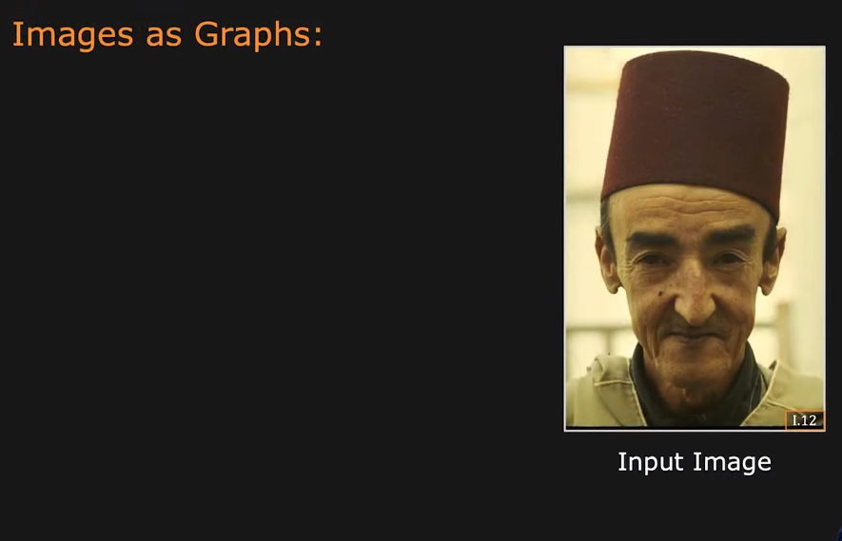
Graph based Segmentation

Slide 4
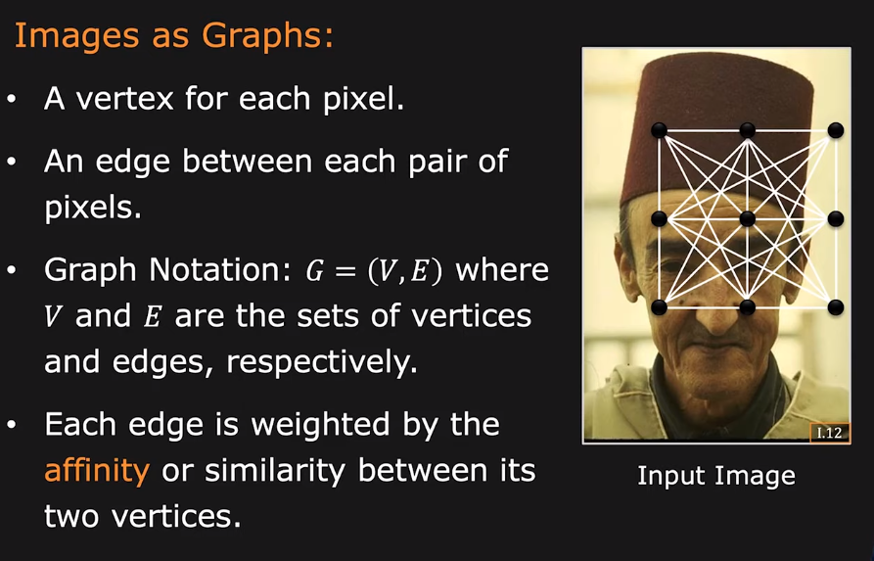
Graph based Segmentation

Slide 5
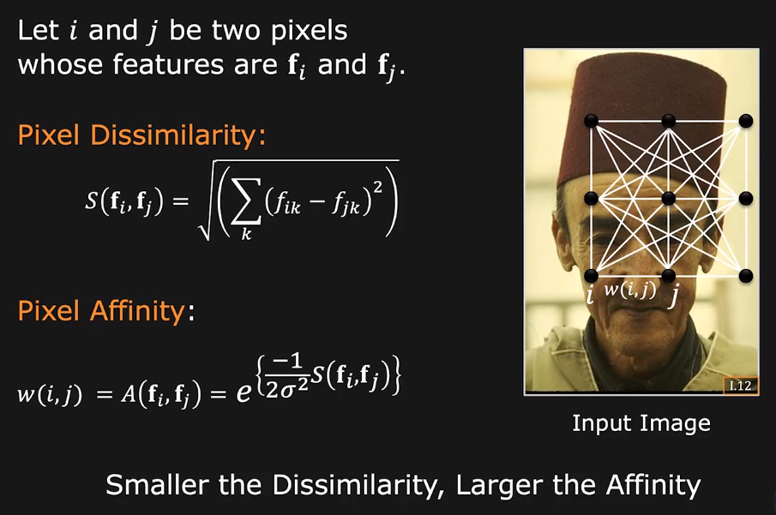
Measuring Affinity

Slide 6
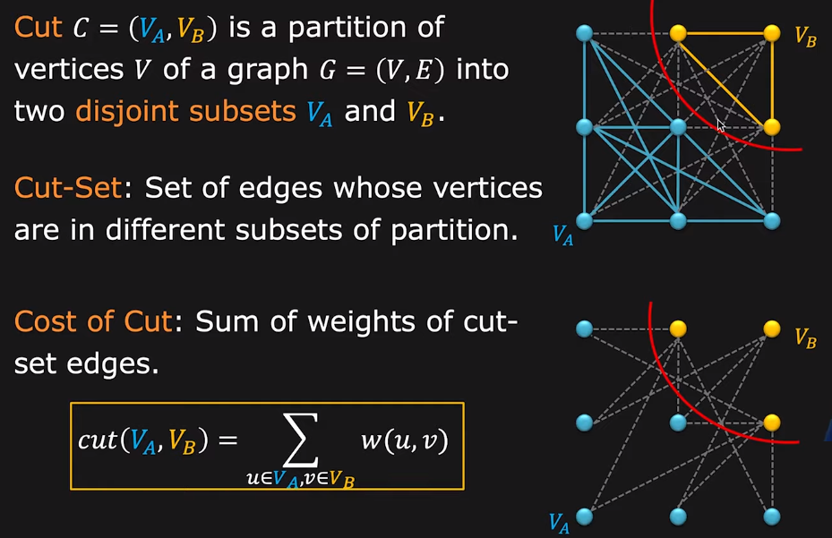
Graph Cut

Slide 7
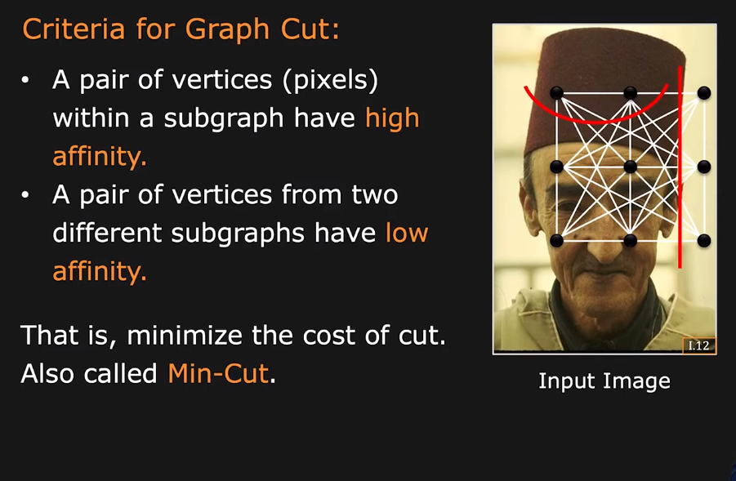
Graph Cut Segmentation

Slide 8
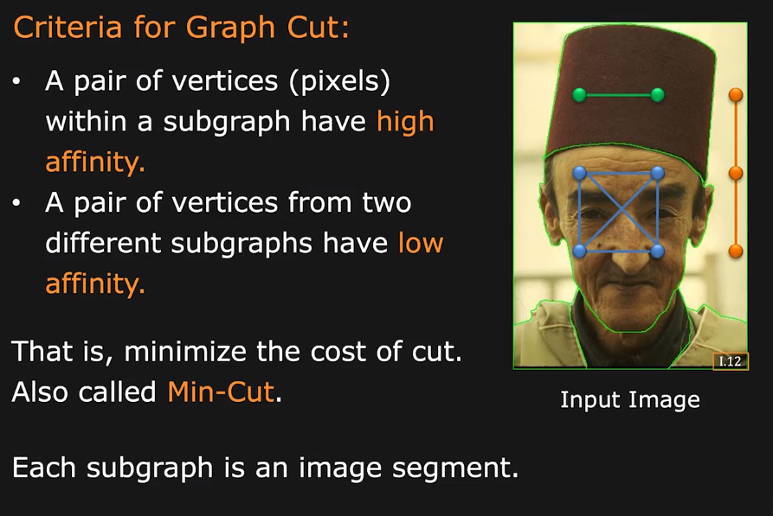
Graph Cut Segmentation

Slide 9
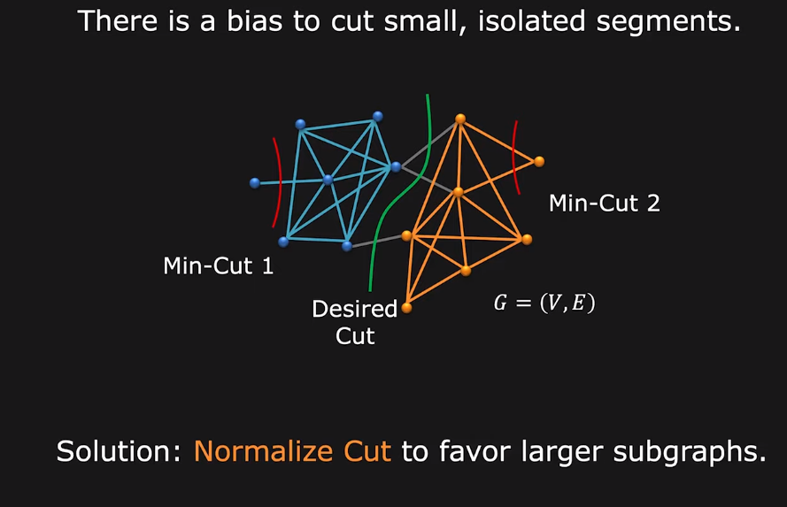
Problem with Min-cut

Slide 10
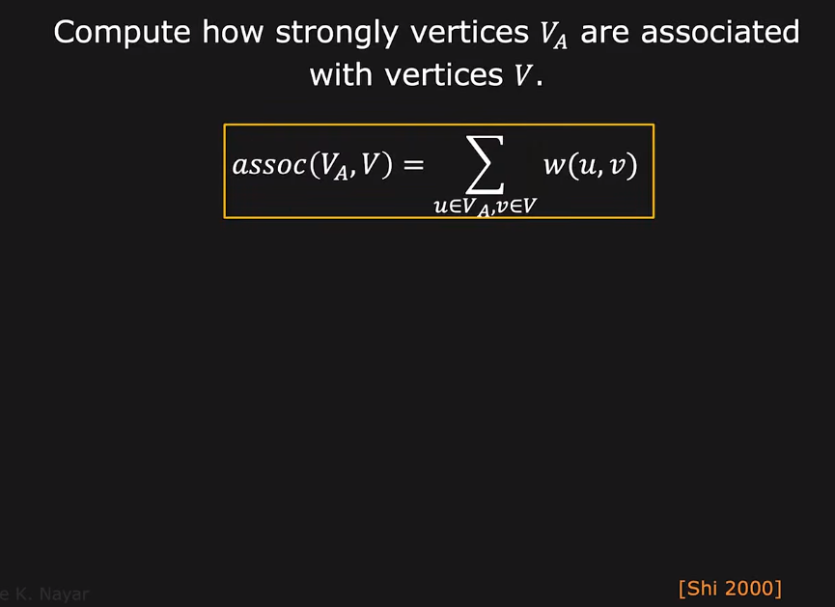
Measure of Subgraph Size

Slide 11
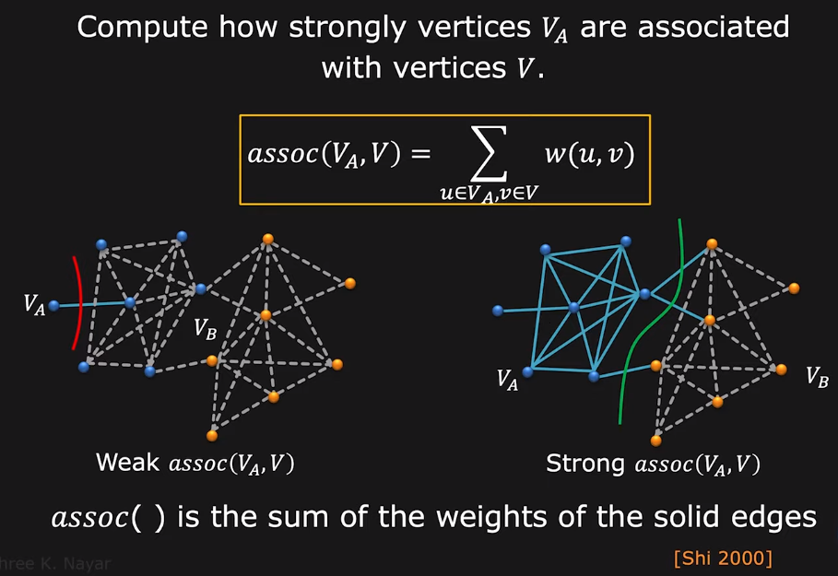
Measure of Subgraph Size

Slide 12
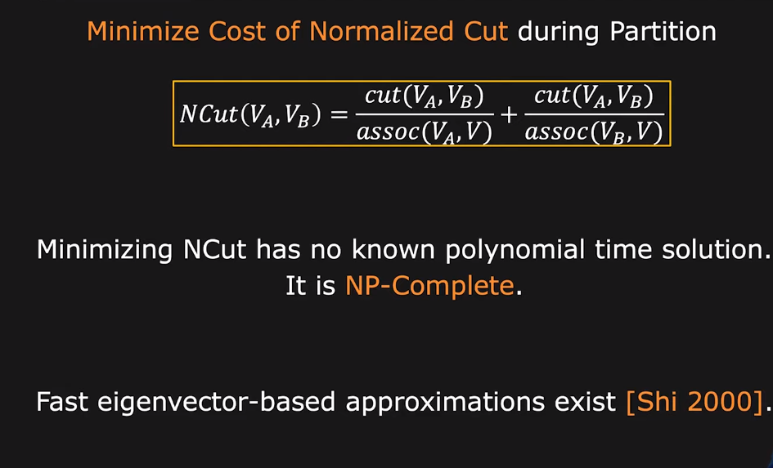
Normalized Cut (N-cut)

Slide 13
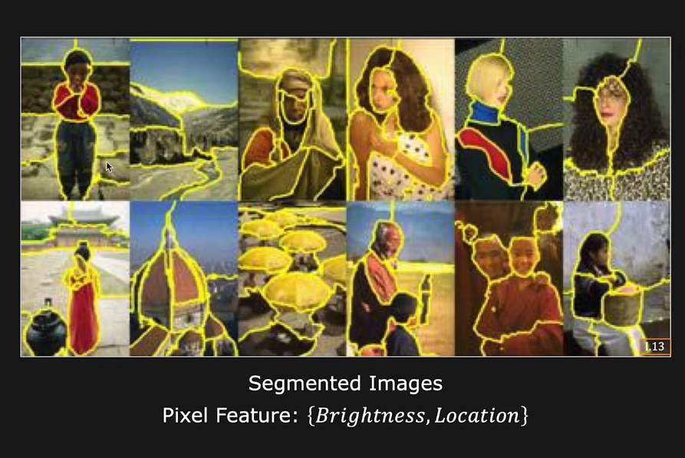
N-cut Segmentation Results

Slide 14
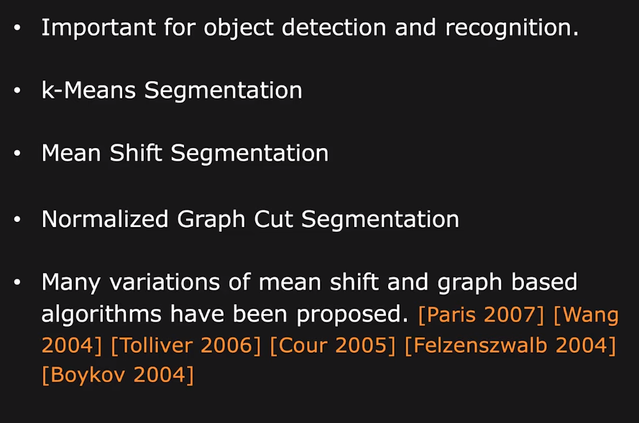
Image Segmentation Summary

